Slide 1
OMNICHANNEL RETAIL SALES AND INVENTORY ANALYTICS DASHBOARD
Presented by: Radhi Ahiwasi Shahil Farshad Internship Organization: Infotact Solutions

Slide 2
INTRODUCTION
- This project focuses on analyzing retail sales data from multiple channels such as store and online platforms.
- The aim is to understand sales performance, customer behavior, and inventory management.
- The project helps in identifying patterns and trends in the data.
- It also supports businesses in making better and data-driven decisions.

Slide 3
OBJECTIVES
- To analyze retail sales data from multiple channels.
- To understand customer behavior and identify high-value customers.
- To identify top-performing products and categories.
- To analyze regional sales performance.
- To monitor inventory levels and identify restocking needs.
- To generate meaningful insights for better business decision-making.

Slide 4
DATASET OVERVIEW
- The dataset contains retail sales and inventory data.
- Total Records: Approximately 1000 rows and 15 columns.
- It includes information related to:
• Order details
• Product details
• Customer segments
• Sales amount
• Inventory levels
- Each row represents a unique transaction.
- The dataset is suitable for analyzing sales performance and inventory management.

Slide 5
Tools used
- Microsoft Excel
• Used for data cleaning and preprocessing
- Python
• Used for Exploratory Data Analysis (EDA)
- Libraries Used:
• Pandas – Data handling
• Matplotlib – Data visualization
• Seaborn – Advanced visualization
- SQL
• Used for basic data querying
- Power BI
• Used to create interactive dashboards and visualizations

Slide 6
Data cleaning
- Data cleaning was performed using Microsoft Excel.
- Removed missing and null values to ensure data accuracy.
- Eliminated duplicate records to avoid repeated data.
- Corrected inconsistent and incorrect entries.
- Standardized data formats, especially for date and numerical fields.
- Ensured all columns have correct data types.
- This step improved data quality and made it ready for analysis.

Slide 7
EXPLORATORY DATA ANALYSIS (EDA)
- EDA was performed using Python to understand the dataset.
- Analyzed sales across different channels, regions, and customer segments.
- Compared product categories to identify top-performing products.
- Studied sales trends over time to identify patterns.
- Evaluated inventory levels to detect low-stock products.
- Helped in discovering patterns, trends, and relationships in the data.

Slide 8
CORRELATION & HEATMAP
- Correlation analysis was performed to understand relationships between variables.
- Strong relationship observed between:
• Sales Amount and Quantity Sold
• Sales Amount and Unit Price
- This shows that sales increase with higher price and quantity.
- A heatmap was used to visually represent these relationships.
- It helps in easily identifying strong and weak correlations in the dataset.

Slide 9
KEY INSIGHTS
- Sales are mainly influenced by quantity sold and unit price.
- Corporate customer segment generates the highest revenue.
- East region shows the best sales performance.
- Store channel slightly outperforms online channel.
- Debit Card is the most commonly used payment method.
- Some products have low inventory and require restocking.
- Sales vary over time, showing peak and low demand periods.

Slide 10
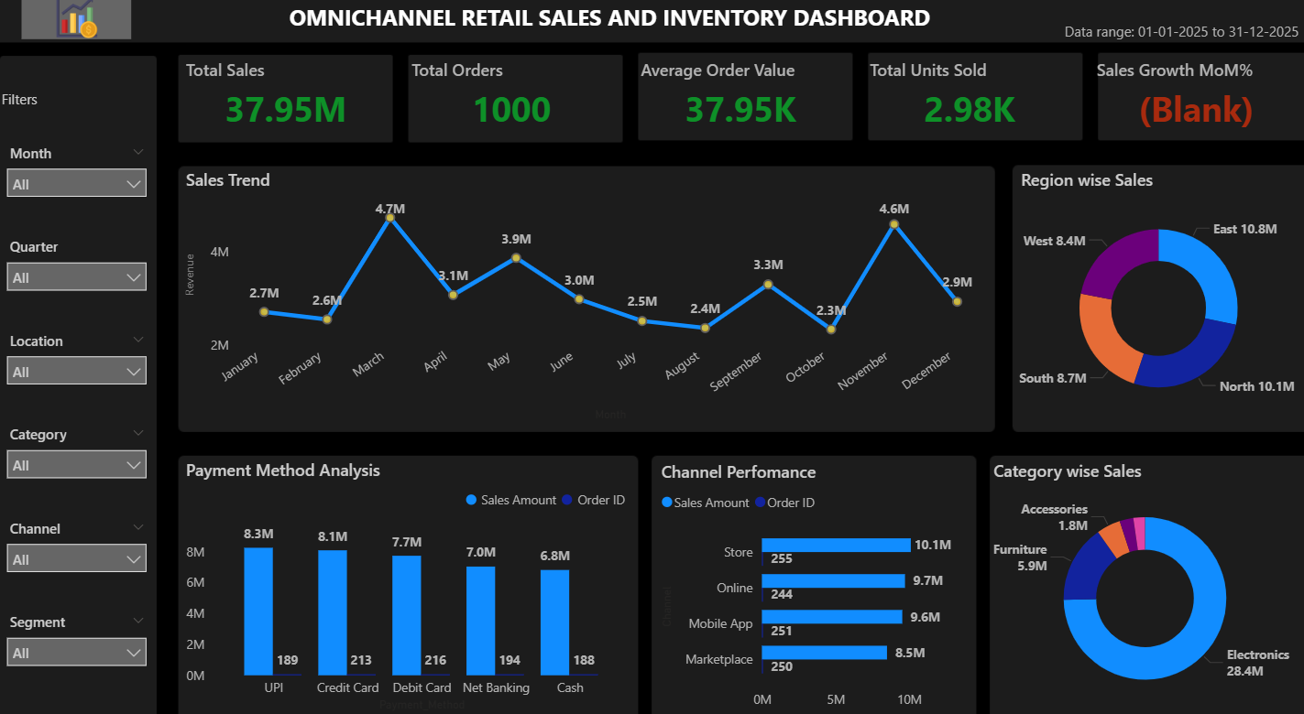
POWER BI DASHBOARD
- An interactive dashboard was created using Power BI.
- It displays key metrics such as Total Sales, Total Orders, and Average Order Value.
- Visualizations include:
• Sales by Category
• Sales by Region
• Sales Trends over Time
• Sales by Channel
- Filters (slicers) are added for better interaction and data exploration.
- The dashboard helps in understanding data easily and supports better decision-making.
- Provides a clear and visual representation of business performance.

Slide 12
DASHBOARD INSIGHTS Key Performance Indicators (KPIs):
- Total Sales: 37.95M indicating strong overall business performance
- Total Orders: 1000 showing consistent customer transactions
- Average Order Value: 37.95K reflecting customer spending behavior
- Total Units Sold: 2.98K representing product demand

Slide 13
Visual insights
Monthly sales trends show fluctuations with peak and low periods
Region-wise analysis indicates that the East region contributes the highest sales
Channel performance comparison shows Store channel leading slightly
- Payment method analysis highlights Debit Card as the most preferred option

Slide 14
Business Impact
Helps in understanding overall sales performance
Identifies high-performing regions and categories
Supports better inventory and sales decision-making
- Enables quick and effective monitoring through visualization

Slide 15
CONCLUSION
- The project successfully analyzed retail sales and inventory data.
- It helped in understanding customer behavior, sales trends, and product performance.
- Sales are mainly influenced by price and quantity.
- Inventory analysis helped identify products that need restocking.
- The Power BI dashboard provided clear and interactive insights.
- Overall, the project supports better business decision-making.

Slide 16
FUTURE SCOPE
- Apply machine learning models to predict future sales trends.
- Implement real-time data analysis for live monitoring.
- Automate data collection and processing using data pipelines.
- Include more customer data for deeper analysis.
- Enhance dashboard with advanced visualizations.
- Develop a web-based system for better accessibility.
- Improve inventory management using predictive techniques.

